Slide 1
Stacked LSTM
杜昀宸

Slide 2
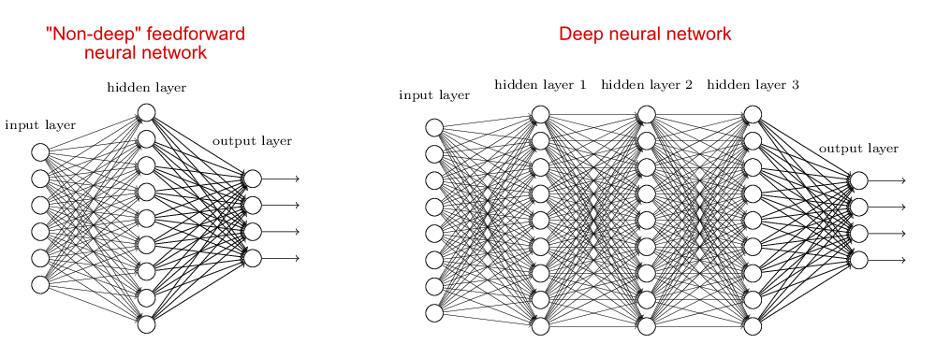
DNN = multi-layer NN

Slide 3
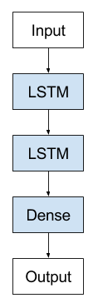
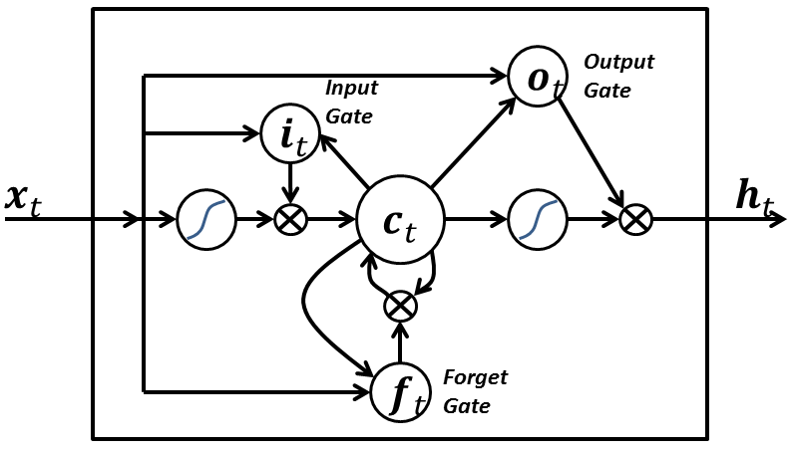
Stacked LSTM = multi-layer LSTM
主要優點: 分層學習特徵

Slide 4
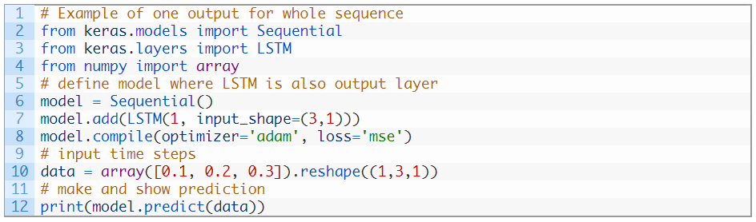

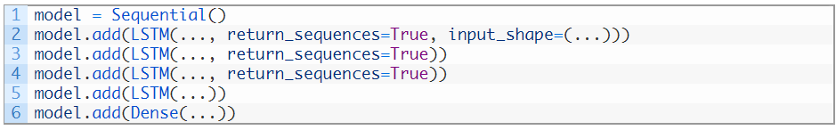
https://machinelearningmastery.com/stacked-long-short-term-memory-networks/

